Slide 1
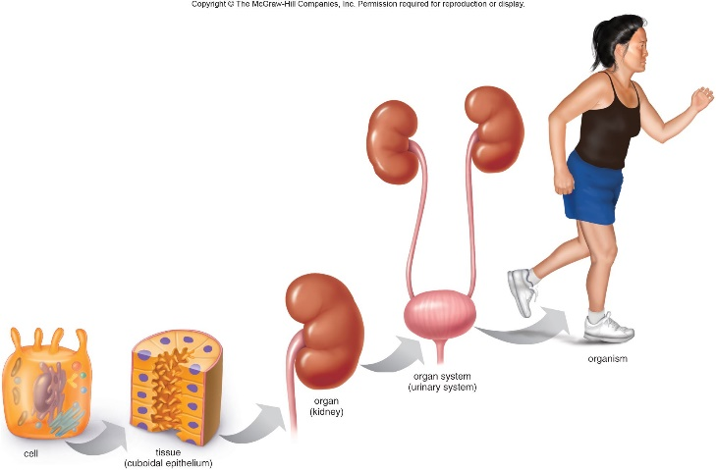
Levels of Organisation
Lesson Objectives:
Define and order cells, tissues, organs, and organ systems according to their relative sizes.
Describe the function of certain organs and organ systems in animal and plants.
Starter 1: Watch video
https://www.youtube.com/watch?v=SzKKYYIlJ-c
https://www.youtube.com/watch?v=mQ26klraKvU
Review:

Slide 2
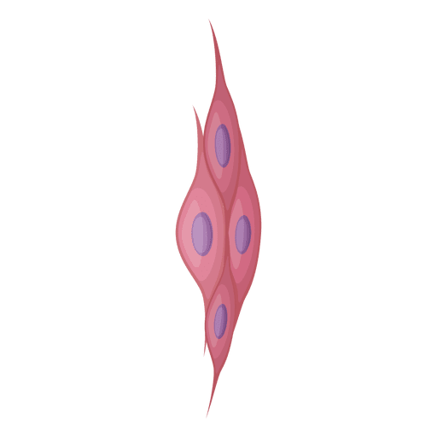
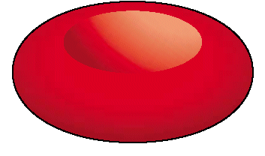
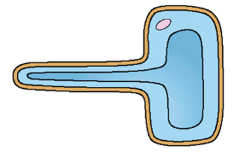

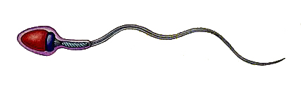
Multicellular organisms have five layer of organisation.
Cells
Cells are the building blocks for life. They
are the first level of organisation.
Cells, cells their made of …
organelles.

Slide 3
Tissues are the second level of organisation.
One cell
A tissue
Can you use this diagram to help come up with a definition of tissue?
Tissue
A group of similar cells
that work together to
perform a certain function.
Tissues
Cells

Slide 4
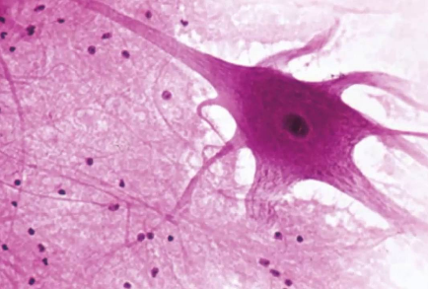
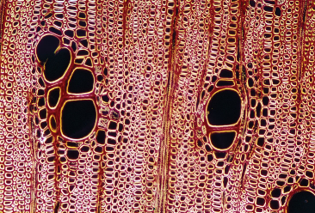
Examples
Muscle Tissue
Nerve Tissue
Plant Xylem Tissue

Slide 5

An organ is a group of different tissues that work together to perform a certain function.
T I S S U E
O R G A N
Organ
Tissues
Cells

Slide 6
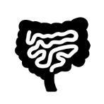



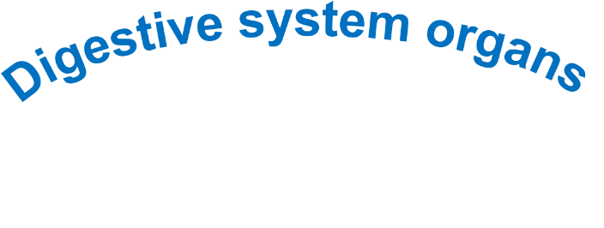
Organs systems are the fourth level of organisation.
Organ
system
Organ
Tissues
Cells

Slide 7
Achieving LO1: Define and order cells, tissues, organs, and organ systems according to their relative sizes
To Do: Match the definition for each keyword
Organ system
Basic building blocks of all living organisms
Organised groups of organs, which work together to for organisms
Tissue
A group of cells with a similar structure and function
Organ
Cell
Groups or aggregations of tissues performing specific functions

Slide 8
Achieving LO1: Define and order cells, tissues, organs, and organ systems according to their relative sizes
To Do: Match the definition for each keyword
Organ system
Basic building blocks of all living organisms
Organised groups of organs, which work together to for organisms
Tissue
A group of cells with a similar structure and function
Organ
Cell
Groups or aggregations of tissues performing specific functions

Slide 9
Achieving LO1: Define and order cells, tissues, organs, and organ systems according to their relative sizes
Levels of Organisation
Organism
Organ
system
Organ
Tissues
Cells

Slide 10
Achieving LO1: Define and order cells, tissues, organs, and organ systems according to their relative sizes
To Do: order each according to their relative size.
Tissue
Cell
Cell
Tissue
Organ system
Organ
Organ
Organ system

Slide 11
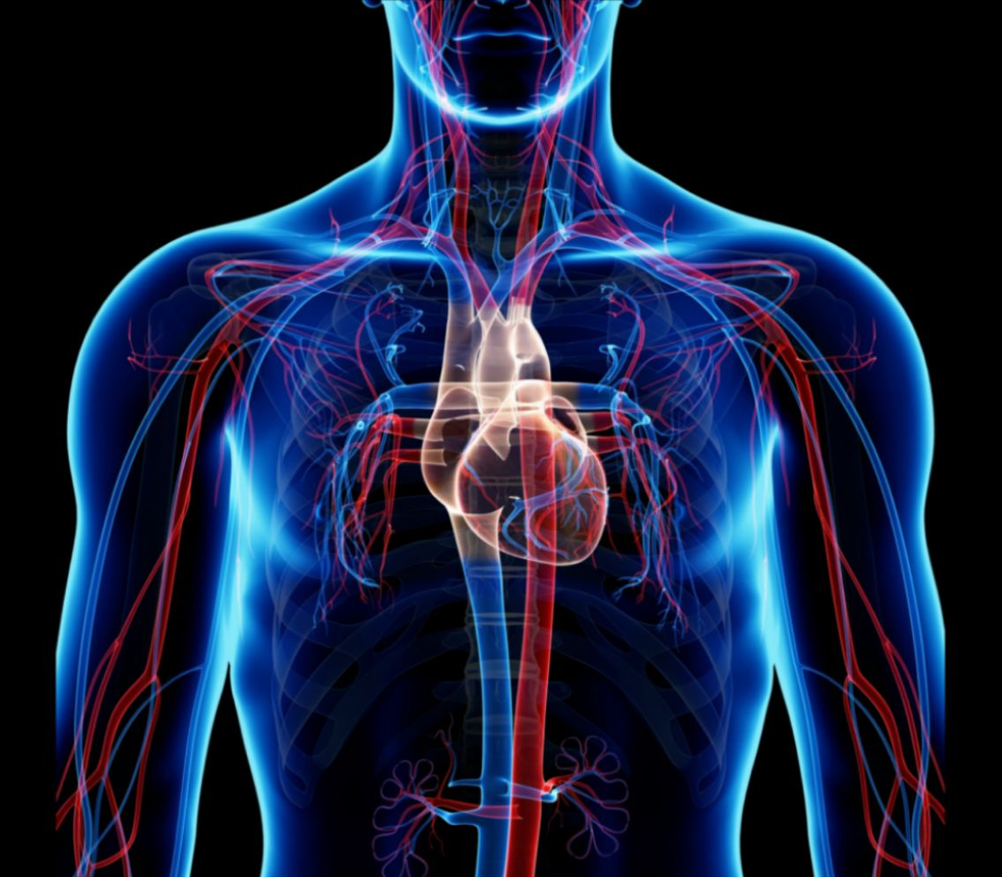
Achieving LO2: Describe the function of certain organs and organ systems in animal and plants
Research Task: Look at the picture of the circulatory system and identify the organ, the tissues and type of cells.
Which organ system is this?
What is its main function?
Give an example of an organ, a tissue, and a cell that it contains.
Introduce how cells are arranged into tissues, and tissues into organs.

Slide 12
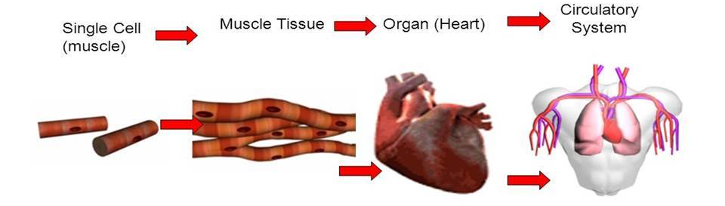
Achieving LO2: Describe the function of certain organs and organ systems in animal and plants
To Do: Look at the picture of the circulatory system and identify the organ, the tissues and type of cells.
Circulatory system:
Pick up and deliver oxygen for respiration

Slide 13
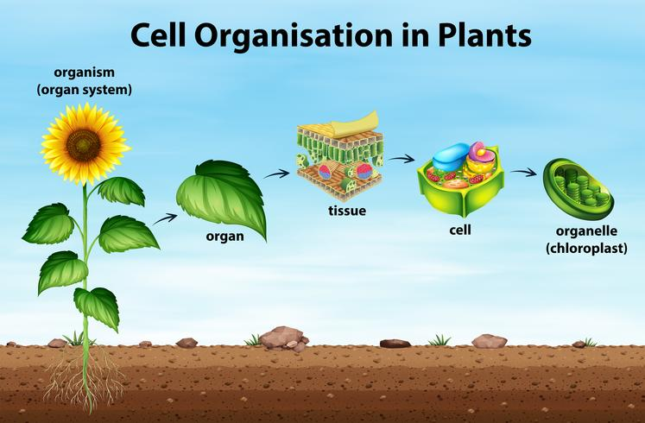
Achieving LO2: Describe the function of certain organs and organ systems in animal and plants
Plants are organisms and follow the same level of organisation

Slide 14
Achieving LO2: Describe the function of certain organs and organ systems in animal and plants
Research Task:
1) To research which cells and tissues are present in the following organs and the organ systems they belong in:
- heart
- stomach
- liver
- pancreas.
2) Write down the function of each organ.

Slide 15
Achieving LO2: Describe the function of certain organs and organ systems in animal and plants
Complete this table and identify these structure as tissues, organs or organs systems
Structure | Tissue | Organ | Organ system
Lining of the stomach
Leaf
Pancreas
Plant
Reproductive system
Heart muscle

Slide 16
Achieving LO2: Describe the function of certain organs and organ systems in animal and plants
Complete this table and identify these structure as tissues, organs or organs systems
Structure | Tissue | Organ | Organ system
Lining of the stomach | ✓
Leaf |  | ✓
Pancreas |  | ✓
Plant |  |  | ✓
Reproductive system |  |  | ✓
Heart muscle | ✓

Slide 17
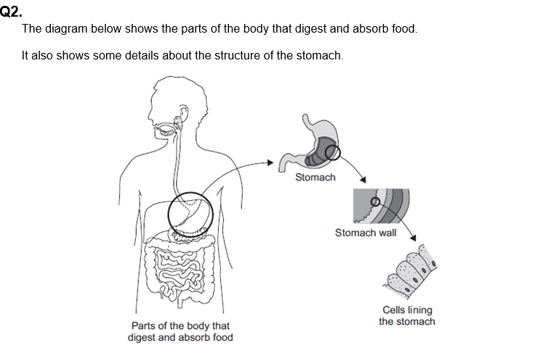
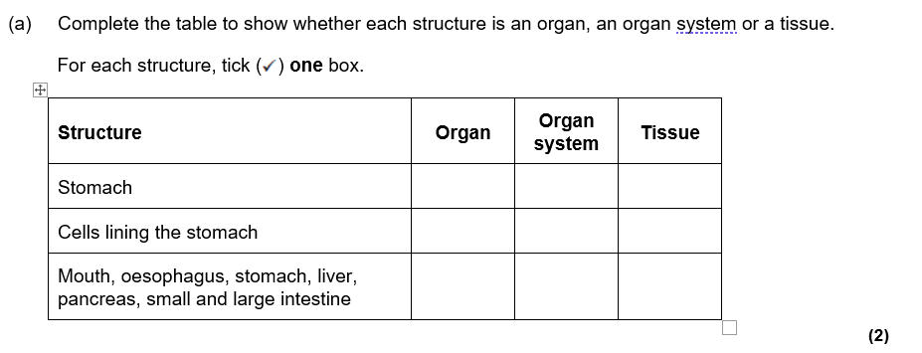

Slide 18
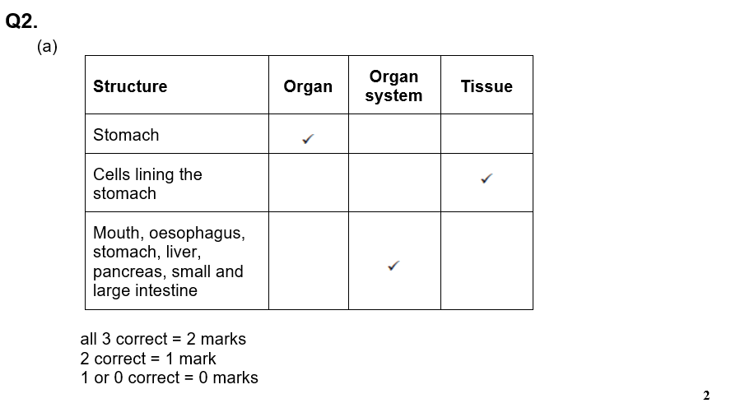
Mark scheme

Slide 19
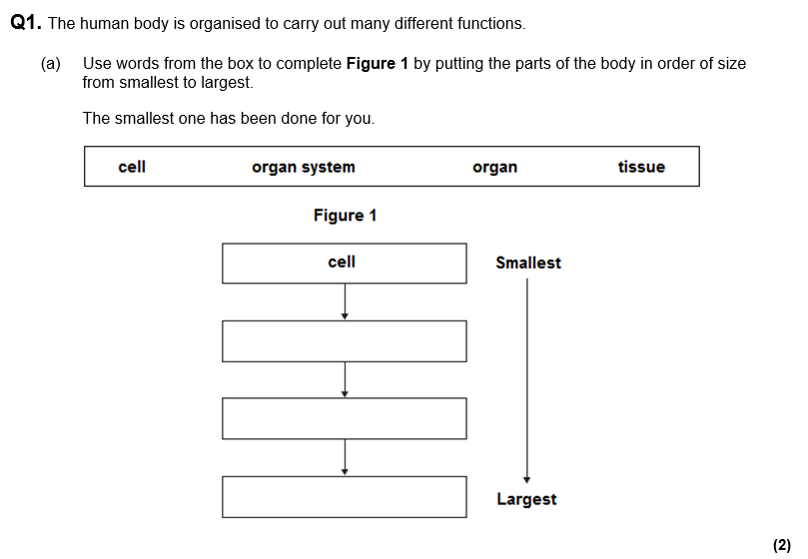

Slide 20
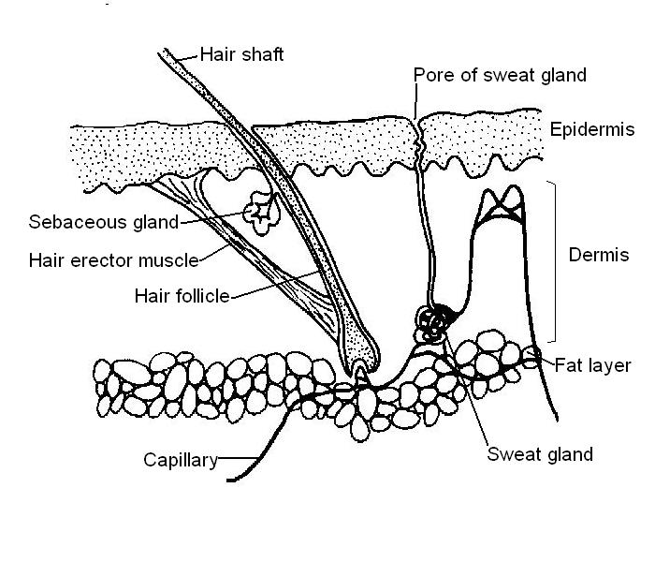

Plenary:
In 5 minutes, use as many of the key words learnt today in a paragraph, explaining why the skin is an organ. Use the diagram to help yourself.

